Slide 1
Microsoft Azure: An Overview
Sneha Jha
Madhurima Rawat
Geetanshu Dev Meshram

Slide 2
Index
Introduction
Origin
Working
Services Comparison
Service Model
Cloud Deployment Model
Benefits
Applications
Future Trends

Slide 3
Introduction
Microsoft Azure is a cloud computing platform launched by Microsoft in 2010.
It provides a wide range of services including computing, storage, networking, AI, machine learning, and IoT.
Azure supports various programming languages, frameworks, and tools, offering flexibility for developers and enterprises.
It emphasizes hybrid cloud solutions, allowing integration between on-premises infrastructure and cloud resources.
Azure's global network of data centers ensures high availability, scalability, and security.
It is deeply integrated with other Microsoft products, making it ideal for businesses using the Microsoft ecosystem.
Azure is a key player in the cloud market, helping businesses with digital transformation and cloud adoption.

Slide 4
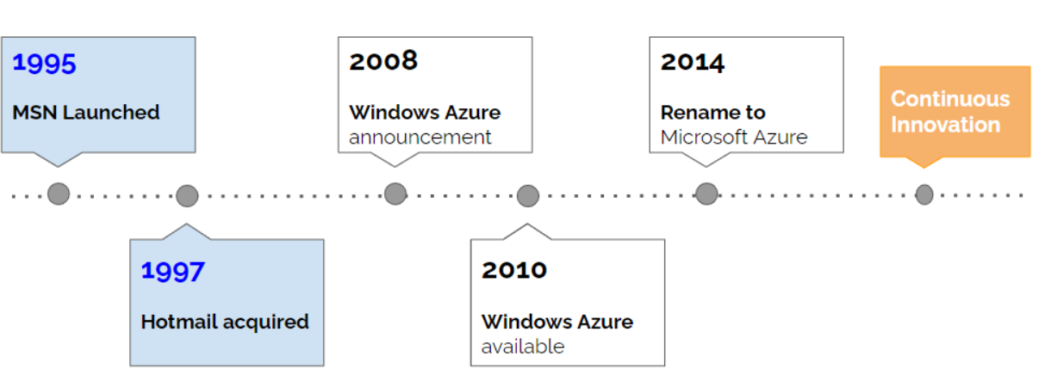
Origin
2008-2010: Azure was announced (2008) and officially launched (2010) as Windows Azure, focusing on PaaS.
2012: Azure expanded to include IaaS with the introduction of Virtual Machines.
2014: Rebranded to Microsoft Azure, signaling broader service offerings.
2015-2017: Growth phase with new services like Machine Learning, IoT Suite, and Azure Stack for hybrid cloud.
2018-2019: Emphasis on Kubernetes (AKS), IoT security (Azure Sphere), and global data center expansion.
2020-2022: Focus on AI, hybrid cloud (Azure Arc), and sustainability initiatives.
2023-Present: Innovation in AI with Azure OpenAI Service and increased focus on industry-specific cloud solutions.

Slide 5
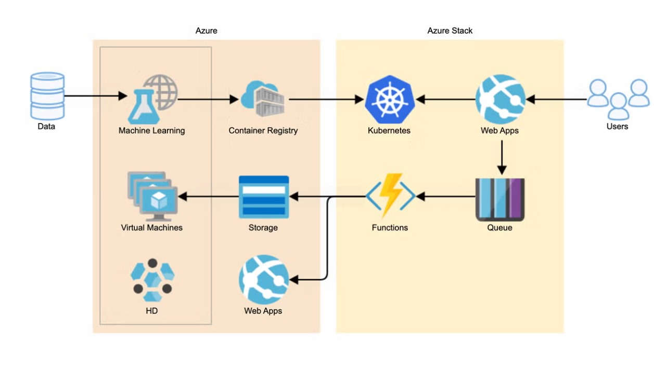
Working

Slide 6
Working
Data: Centralized data storage for processing and analysis across services.
Machine Learning: Develops, trains, and deploys predictive models using data.
Virtual Machines: Provides customizable compute environments for running applications.
Storage: Manages and retrieves large amounts of data efficiently.
Web Apps: Builds, deploys, and scales web applications.
Container Registry: Stores and manages container images for deployment.
Kubernetes: Deploys and manages containerized applications using AKS.
Functions: Executes serverless code triggered by events or schedules.
Queue: Facilitates message queuing for asynchronous processing between services.
Azure Stack: Enables hybrid cloud solutions with consistent deployment across cloud and on-premises.

Slide 7
Services Comparison
Feature/Aspect | Microsoft Azure | Amazon Web Services (AWS) | Google Cloud Platform (GCP)
Launch Year | 2010 | 2006 | 2011
Market Share | Second largest (as of 2025) | Largest (as of 2025) | Third largest (as of 2025)
Key Strengths | Hybrid cloud, Microsoft integration | Extensive services, scalability | AI/ML, data analytics
Hybrid Cloud | Strong (Azure Arc, Stack) | Moderate (AWS Outposts) | Moderate (Anthos)
AI/ML Services | Azure Machine Learning | AWS SageMaker | Google AI, TensorFlow
Kubernetes | Azure Kubernetes Service (AKS) | Amazon EKS | Google Kubernetes Engine (GKE)
Pricing Model | Pay-as-you-go, Reserved | Pay-as-you-go, Reserved | Pay-as-you-go, Sustained discounts
Popular Use Cases | Enterprise apps, hybrid cloud | Broad use cases | AI/ML-heavy apps, analytics

Slide 8
Service Model
Aspect | Infrastructure as a Service (IaaS) | Platform as a Service (PaaS) | Software as a Service (SaaS)
Example Services | Azure Virtual Machines (VMs), AKS | Azure Machine Learning, Azure App Service | Azure Cognitive Services, Power BI
Control | Full control over infrastructure | Managed infrastructure, focus on apps | Fully managed services, ready-to-use
Management | Users manage OS, scaling, updates | Azure manages infrastructure, users manage apps | Azure manages everything
Deployment | Deploy models on VMs or containers | Deploy models via Azure ML, App Service | Use pre-built models or APIs
Customization | High customization, full control | Limited to platform capabilities | Minimal customization, out-of-the-box functionality
Use Case | For complex, customized environments | For quick deployment with minimal infra management | For rapid use of AI capabilities without deployment
Scaling | User-defined scaling | Azure handles scaling | Scaling managed by Azure

Slide 9
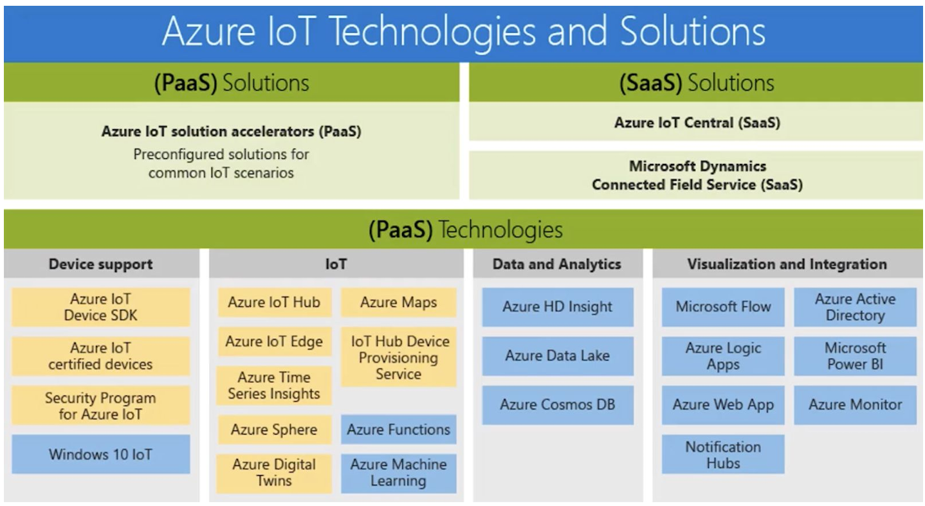

Slide 10
Cloud Deployment Models
Public Cloud | Private Cloud | Hybrid Cloud
The Public Cloud model is the most common deployment model, where cloud resources are owned and operated by a third-party cloud service provider, such as Microsoft Azure. | The Private Cloud model involves cloud resources used exclusively by a single organization. These resources can be physically located on the organization’s premises or hosted by a third-party service provider. | The Hybrid Cloud model combines Public and Private Clouds, allowing data and applications to be shared between them.
These resources are delivered over the internet and shared among multiple organizations. | The key aspect is that the infrastructure is dedicated to a single entity. | This approach offers greater flexibility, optimized workload management, and enhanced security.
Azure App Services: Deploy web apps and APIs. Azure Kubernetes Service (AKS): Manage Kubernetes clusters. Azure Blob Storage: Store and manage large amounts of unstructured data. | Azure Stack: Extend Azure services to your own data center. Azure Private Link: Securely connect to Azure services over a private network. Azure Virtual Network: Create isolated network environments. | Azure Arc: Manage and govern resources across on-premises, multi-cloud, and edge environments. Azure Site Recovery: Ensure business continuity with disaster recovery solutions. Azure Hybrid Benefit: Maximize savings by using existing on-premises licenses in the cloud.

Slide 11
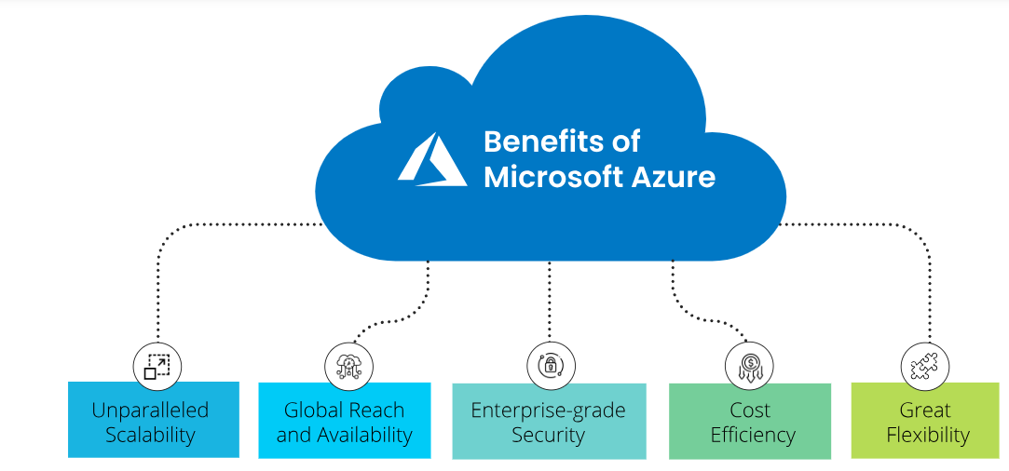
Benefits

Slide 12
Applications
Enterprise Applications: Azure provides robust solutions for enterprise-grade applications, ensuring high availability, disaster recovery, and business continuity.
Data Analytics: Azure Synapse Analytics integrates big data and data warehousing to offer insights at scale. Services like Azure Data Lake and Azure Databricks enhance data processing capabilities.
Gaming: Azure PlayFab offers a complete backend platform for building and managing live games, supporting features like player authentication, in-game analytics, and real-time data processing.
Healthcare: Azure supports healthcare solutions with services for secure data storage, compliance, and AI-driven diagnostics, enabling improved patient care and operational efficiency.
BMW: Uses Azure for connected car services, leveraging IoT and AI to enhance driver safety and vehicle performance.
eBay: Employs Azure for real-time data analytics, improving decision-making processes and customer experiences.
Industry Impact: Azure has driven digital transformation across industries such as finance, healthcare, manufacturing, and education, enabling innovation and operational efficiency.

Slide 13
Future Trends
AI and Machine Learning: Azure AI services, including Azure Machine Learning and Cognitive Services, continue to evolve, providing advanced tools for building intelligent applications.
Edge Computing: Azure IoT Edge enables real-time data processing closer to the data source, improving response times and reducing the need for cloud connectivity.
Quantum Computing: Azure Quantum offers a full-stack, open cloud ecosystem for quantum computing, enabling research and development in this cutting-edge field.
Hybrid Cloud Solutions: Azure Arc extends Azure management capabilities to on-premises, multi-cloud, and edge environments, offering a consistent management layer.

